Slide 1
Army Wheel Assembly Program
July 24, 2012

Slide 2
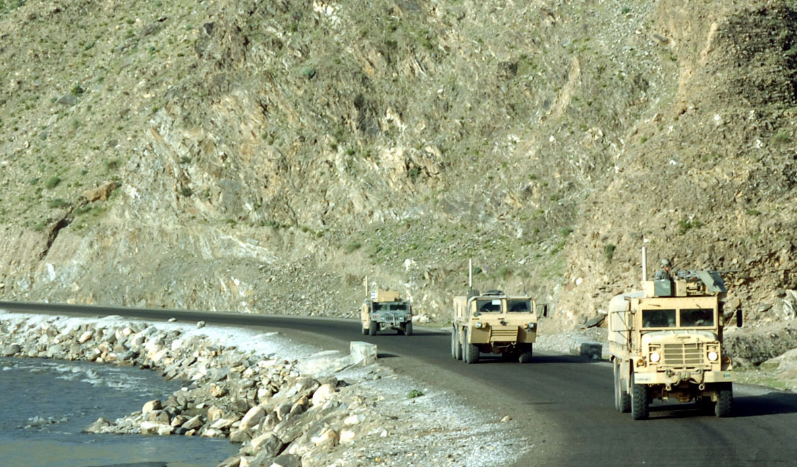
Purpose
To provide a summary of the Army Tactical Wheel Vehicle (TWV) Strategy and the Army Wheel Assembly Program.

Slide 3
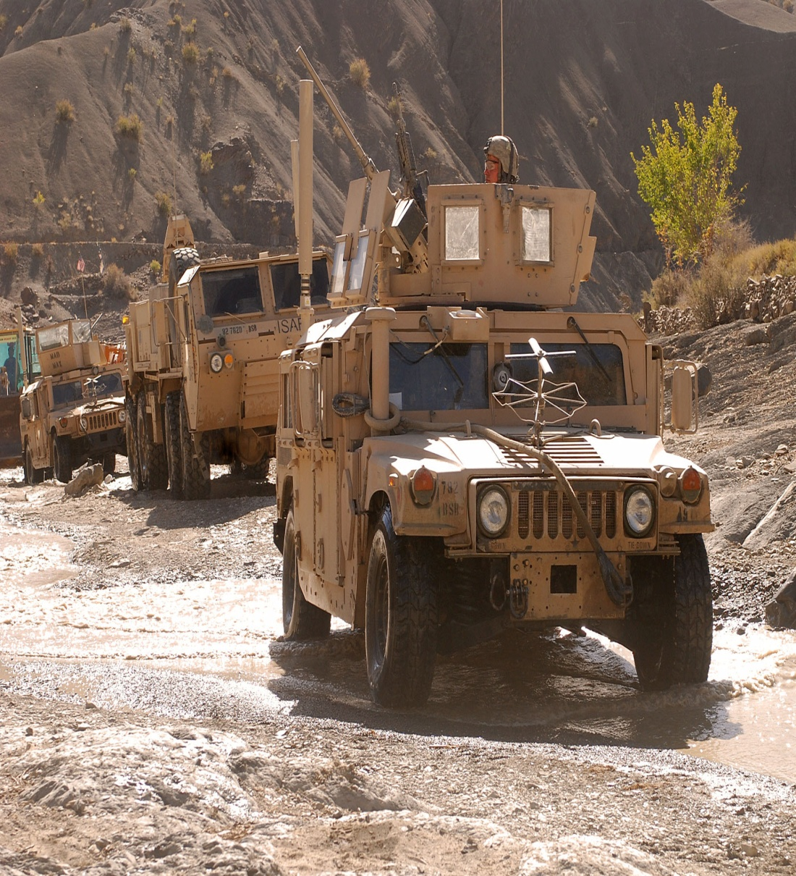
Agenda
Two-Level Maintenance (TLM)
TWV Strategy
Wheel Assembly Program
National Maintenance Program
Current Demands
Questions

Slide 4
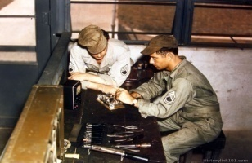
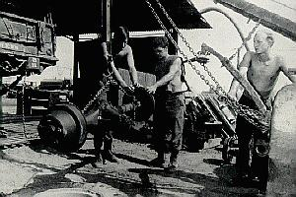
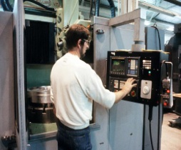
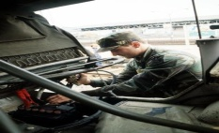
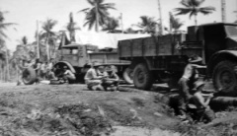
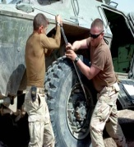
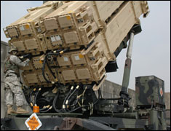
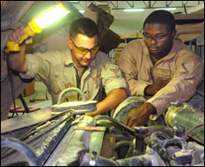
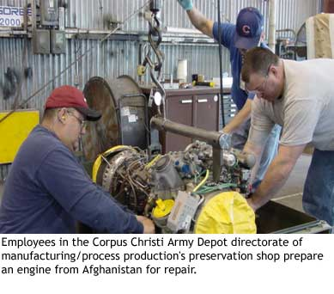
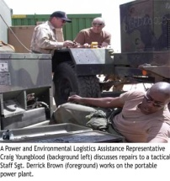
Army Maintenance Transformation
Four Level Maintenance System
Analysis
Assessment
(System since 1940s)
Organizational
Direct Support
General Support
Depot
Crew/Operator
UNIT
Echeloned maintenance
Large logistics footprint
Reliant on evacuation systems
Built-in C2 overhead burden
Backup maintenance support
May 2003
Problem… built in duplication and redundancies…
Series TMs | Operator / Crew (10) | Organizational (20) | Direct Support (30) | General Support (40) | Depot (50)
MAC | C | O | F | H | D
Mar 2008
Efficiencies
Realized
Series TMs | Operator / Crew (10) | Maintainer (30) | Below Depot (40) | Depot (50)
MAC | C | F | H | D
-Reduced footprint
-Less evacuation time
-Self contained
-Streamline C2
-Faster response
-Modular
Field
Sustainment
Two Level Maintenance System

Slide 5
Two-Level Maintenance Definition
Field Level Maintenance
Generally characterized by on-(near) system maintenance, often utilizing line replaceable units (LRU's) and component replacement, in the owning unit, using tools and test equipment found in the unit.
It is not limited to simply "remove and replace“ actions, but also allows for repair of components or end items on-(near) systems. Field maintenance also includes adjustments, alignments, services, applying approved field-level modification work orders (MWO), faults/failure diagnoses, battle damage assessment, repair, and recovery.
Field level maintenance always repair and return to the user, and includes maintenance actions able to be performed by operators.
Field
Notes:
#5 - be sure they understand we still do repair and return of components and assemblies at the tactical level, it's not just a swap or plug and play.

Slide 6
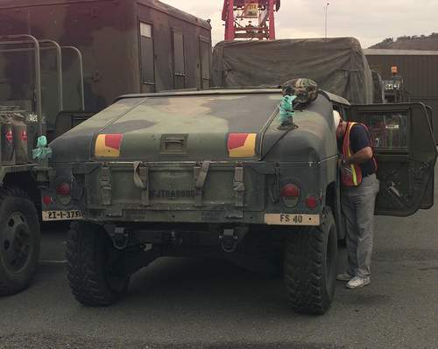
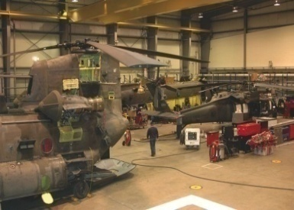
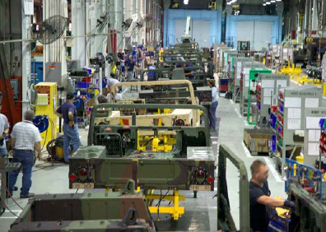
Two-Level Maintenance Definition
Sustainment Level Maintenance
Generally characterized by "off system“ component repair and/or end item repair and return to the supply system, or by exception, back to the owning unit. It is performed by national-level maintenance providers (including the Army Materiel Command and Installation DOL Maintenance Activities).
The sustainment maintenance function can be employed at any point in the integrated logistics chain. The intent of this level is to perform commodity-oriented repairs on all supported items to return them to a national standard, providing a consistent and measureable level of reliability, and to execute maintenance actions not able to be performed at the field level of maintenance.
Sustainment
Notes:
#6 - for the sustainment or national level it's repair to a national standard (remanufacture in essence)

Slide 7
Two-Level Maintenance Repair Criteria
Field Level Maintenance
All units perform field maintenance or are supported by field maintenance organizations.
Field maintenance is generally characterized by three criteria:
Performed on or near the system.
Normally consists of component replacement but also includes adjustments, alignments, services, applying approved field-level modification work orders (MWO), faults/failure diagnoses, battle damage assessment, repair, and recovery.
Is always return to the user.
REF 750-1
Sustainment
Notes:
#7 - 10/20, not just FMC

Slide 8
Two-Level Maintenance Repair Criteria
Sustainment Level Maintenance
Army Materiel Command, LCMCs, Depots, National Maintenance Points (NMP), Arsenals and Installation DOL Maintenance Activities.
Sustainment maintenance is generally characterized by these three criteria:
Performed off system.
Consists of component and/or end-item repair.
Is normally return to the supply system but, by exception, can be returned to the user.
REF 750-1
Sustainment

Slide 9
TWV Strategy
The Army’s objective is an affordable strategy to ensure that Soldiers operating within Army Force Generation (ARFORGEN) have the right balance of vehicle quantities, types and modernization to meet their mission requirements – whether in combat, training, operating as part of the Army’s generating force or conducting Homeland Defense and Defense Support to Civil Authorities.
REF TWV STRATEGY 10’
Notes:
#9 - not every Army operational unit is an ARFORGEN force pool unit. So we equip to the Army equipping and modernization strategy. Not just ARFORGEN
Fine but for one point ... we have units that are not now or every have been part of the ARFORGEN rotational pool. We equip to the Army's Equipping and Modernization Strategies.

Slide 10
TWV Objectives
Strategic TWV Objectives:
Fleet Operations:
Forces equipped with TWV capabilities to meet all mission requirements from general purpose trucks to armor capable and projected platforms with specific functional capabilities.
Forces trained to ensure the safe and successful employment of their vehicles.
Fleet Size and Mix:
Strategy will be affordable given current budget estimates.
Swiftly modernize critical Light Tactical Vehicle (LTV) combat platforms to mitigate capability gaps remaining in the LTV fleet not addressed with the High Mobility Multipurpose Wheeled Vehicle (HMMWV) and Mine Resistant Ambush Protected (MRAP) Family of Vehicles (FoV).
Progressively modernize all TWV fleets to improve fleet capability to include reliability and operational readiness and reduce fleet age and operating costs.
MRAP FoV integrated into the Army force structure to take advantage of existing systems to meet documented requirements and to reduce operating costs by divestment of duplicative systems.
REF TWV STRATEGY 10’

Slide 11
TWV Approaches
Fleet Operations:
Equip Forces in accordance with ARFORGEN.
Equip Army with vehicle training sets and simulation devices for training during Reset and Train/Ready phases .
Fleet Size and Mix:
Shape TWV fleet size and mix to ensure long term affordability through new procurement, recapitalization and divestment; leverage existing assets to the greatest extent.
Implement recommended reductions, and then procure and equip to 100% of remaining authorizations.
Maintain peak vehicle age close to the estimated Economic Useful Life (EUL) of 15 and 20 years (LTV and MTV/HTV, respectively) by replacing vehicles every 40 years and recapitalizing them once midway.
EUL: The average age at which replacing an old vehicle with the same type or new vehicle minimizes the life-cycle cumulative cost of ownership for a fleet of similar vehicles.
Notes:
#11 - not every Army operational unit is an ARFORGEN force pool unit. So we equip to the Army equipping and modernization strategy. Not just ARFORGEN
Fine but for one point ... we have units that are not now or every have been part of the ARFORGEN rotational pool. We equip to the Army's Equipping and Modernization Strategies.

Slide 12
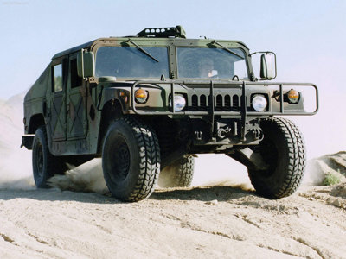
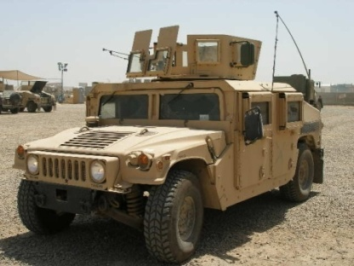
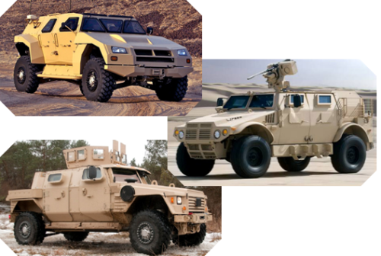
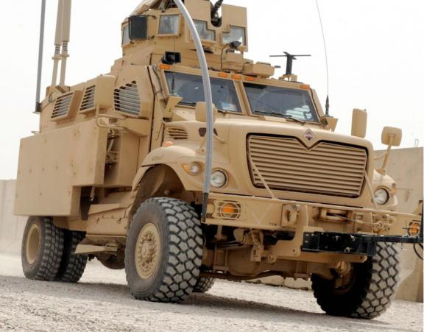
TWV Requirements Evolution of the TWV Fleet: LTV Fleet Example
The Army’s vision of the truck has been transformed by lessons learned in the past two decades – Operational lessons from Somalia to OIF/OEF have demonstrated the need for a protected system capable of operating in a full-spectrum, non-linear battlefield
Performance
Performance
Performance
Balance between performance & payload
Protection added at expense of performance & payload
Performance and protection goals expanded
HMMWV
Cost ~ $70K*
UAH
JLTV
Cost ~ $300K+
Cost ~ $222K (as shown)
Payload
Protection
Payload
Protection
Payload
Protection
M1025 Armament Carrier
M1151 Armament Carrier
JLTV
Operational Solutions
(Bridge to JLTV)
Protection increased at expense of size and off-road mobility
Protection above Cat I MRAP but below Cat II; off-road mobility restored; size reduced, but still larger than LTV objectives
Cost ~ $600 - $900K
Cost ~ $437K
*Converted to present-day dollars
Category I MRAPs
M-ATV

Slide 13
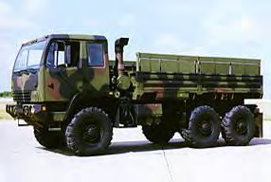
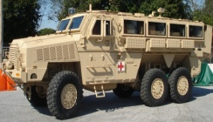
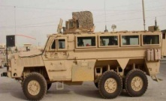
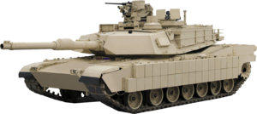
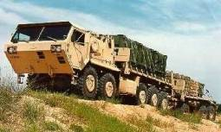
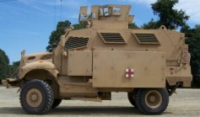
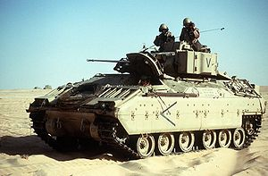
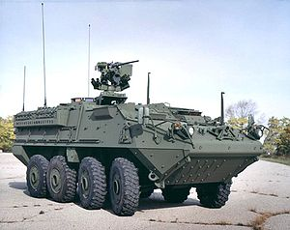
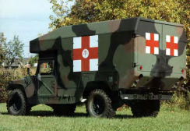
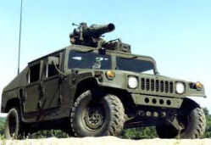
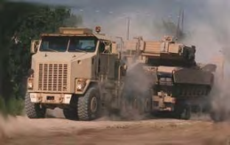
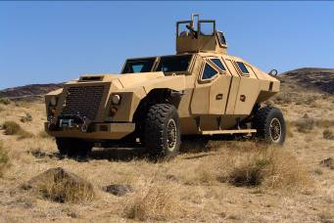
No single TWV system balances the iron triangle of payload, performance and protection along with transportability
Traditionally Tactical Wheeled Vehicles
Traditionally Combat Platforms
Examples of Heavy & Medium Fleet Trucks
Examples of HMMWV Family of Vehicles
Examples of MRAP Family of Vehicles and JLTV
Army’s Traditional Ground Combat Platforms
FMTV
MRAP HAGA
MRAP RG 33L
HMMWV Shelter Carrier
Up-armored HMMWV
M1A1 Abrams Tank
MaxxPro Cat I Ambulance
PLS
MRAP Cougar
ASV
HET
HMMWV Ambulance
HMMWV TOW Carrier
Bradley Fighting Vehicle
Stryker
JLTV Prototype
Distinct Combat Service Support missions
Multiple Combat, Combat Service, and Combat Service Support mission roles to include recon, convoy operations, troop transport, CASEVAC, Heavy Guns Carrier, C2OTM, Combat Engineer and EOD missions for maneuver units
Distinct Combat mission roles (although Stryker and Bradley Hull designs can be used for CSS variants, i.e., Ambulance)

Slide 14
Wheel Assembly Maintenance
Wheel Assemblies are not repaired at the Unit level. Under Two-Level maintenance doctrine, units turn in their unserviceable wheel assemblies to their supporting Supply Support Activity (SSA) and receive a serviceable one in return. AMC repairs the unserviceable wheel assemblies and returns them to stock for reissue as a complete wheel assembly.

Slide 15
Wheel Assembly Transition Timeline
Five National Wheel Assembly Sites go live:
Ft Bliss
Ft Lewis
Ft Sill
Korea
Germany
2008
Two-Level Maintenance Approved by TRADOC
November 2005
October 2004
June 2003
Wheel Assemblies integrated into NMP
January 2001
Fort Lewis BCT Pilot Test Ends
CASCOM/TACOM Wheel Assembly Study

Slide 16
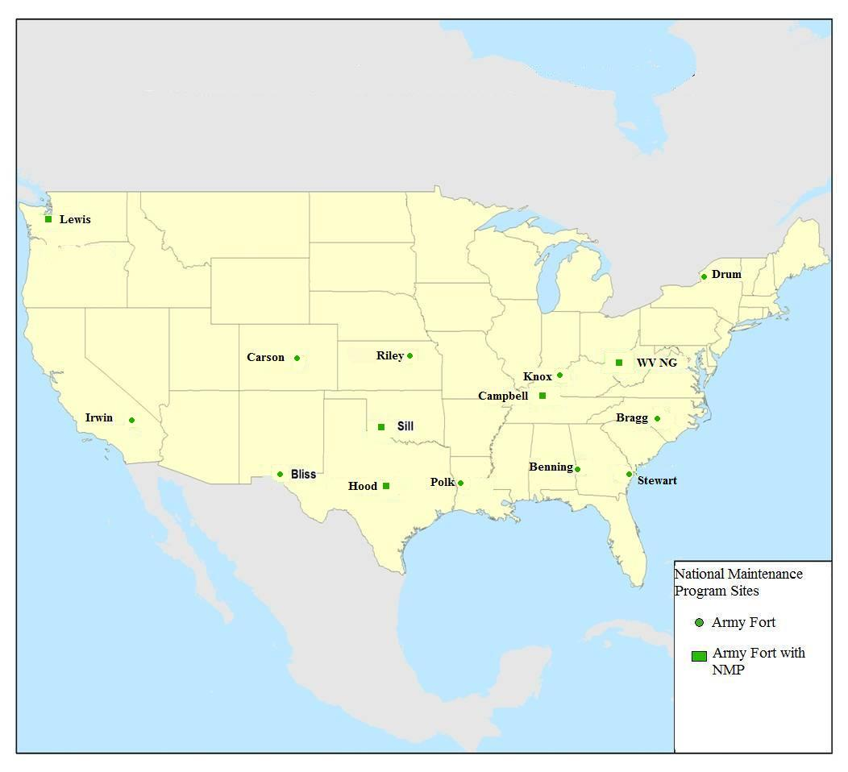
National Maintenance Program
CONUS
Fort Campbell, KY
Fort Sill, OK
Fort Hood, TX
Fort Lewis, WA
West Virginia National Guard
OCONUS
Kuwait
Afghanistan
Germany
Korea

Slide 17
Top 15 Wheel Assembly Quantities FY 10 and FY 11
NIIN | Vehicle | 2010 Qty | 2011 Qty
01-506-5762 | M1000 HET Trailer | 11,845 | 12,209
01-493-5859 | HMMWV / M1101 Trailer L/R D | 12,914 | 10,305
01-506-2715 | M1070/74/75 PLS/HET Truck w CTIS | 4,123 | 5,101
01-477-1660 | M977 HEMTT w/o CTIS | 6,613 | 4,978
01-565-2137 | BAE TVS Caiman PLUS | 1,876 | 4,429
01-558-2138 | HMMWV / M1101 Trailer L/R D (24 Bolt Rim w/ Michelin Baja / Goodyear MTR tire) | 6,571 | 4,366
01-500-4619 | M1083/84/85 FMTV | 5,486 | 4,269
01-563-8620 | HMMWV / M1101 Trailer L/R E (24 or 20 Bolt Rim w/ Goodyear MTR tire / Michelin Baja T/A) | 5,541 | 4,085
01-555-5456 | Navistar MaxxPro & MaxxPro PLUS (Front Axle) | 3,167 | 2,215
01-565-5657 | Navistar MaxxPro PLUS (Rear Axle) | 2,148 | 2,044
01-555-4749 | BAE TVS Caiman | 2,940 | 1,732
01-506-7646 | M870A1 Trailer | 1,739 | 1,669
01-506-7243 | M923A1 & M939A1/A2 | 2,553 | 1,611
01-547-4136 | M872 Trailer Series | 1,392 | 1,601
01-506-4128 | M915A3 | 1,089 | 1,354

Slide 18
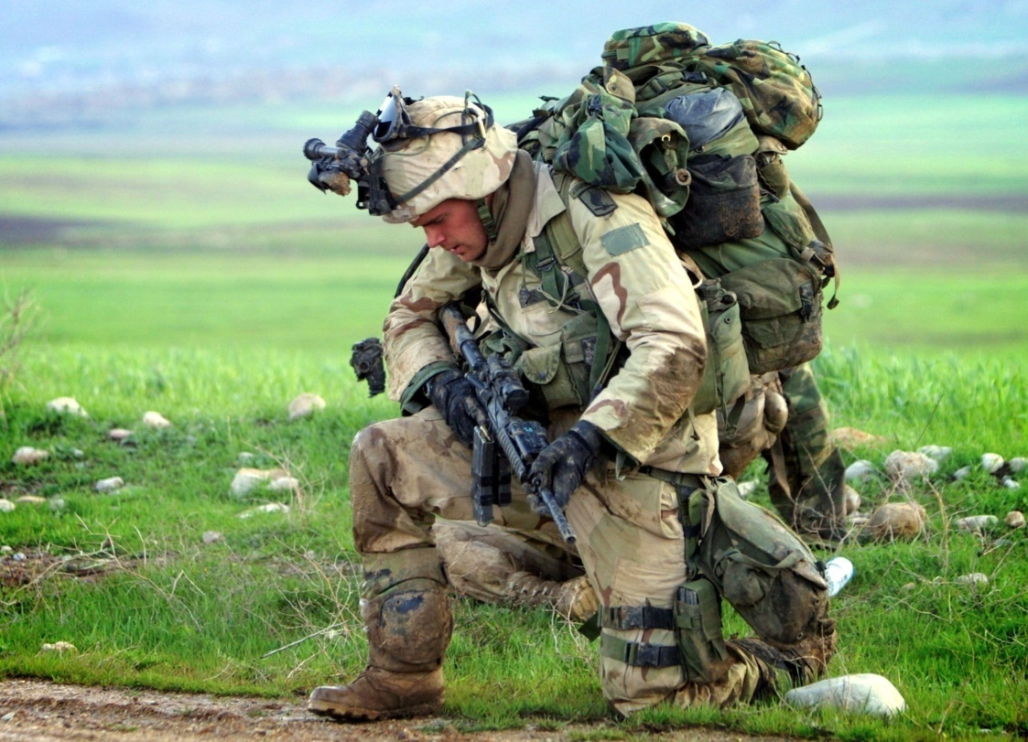
One Thing Remains Constant
Army will always count on ARMY STRONG Logisticians with boots on the ground!!
Soldiers are the centerpiece of our Army
Living the Warrior Ethos - on duty protecting the Nation and the society they serve.
Notes:
In the midst of change …you all know the soldier remains the centerpiece of the Army and the Army will always count on Army strong Logisticians with boots on the ground
Thank you and I look forward to your questions

Slide 19
Questions?

Slide 20
Back-Ups

Slide 21
Wheel Assembly Quantities FY 10 and FY 11 |  | Quantity
NIIN | Vehicle | 2010 Qty | 2011 Qty
01-446-1035 | 10K ATLAS Forklift - Right | 736 | 794
01-477-1660 | M977 HEMTT w/o CTIS | 6,613 | 4,978
01-478-0593 | M117 Armored Security Vehicle (ASV) | 973 | 48
01-484-1419 | 50K RTCH (Kalmar) | 80 | 61
01-493-5859 | HMMWV / M1101 Trailer L/R D | 12,914 | 10,305
01-500-4619 | M1083/84/85 FMTV | 5,486 | 4,269
01-500-4991 | M1076 PLS Trailer | 1,030 | 811
01-506-2715 | M1070/74/75 PLS/HET Truck w CTIS | 4,123 | 5,101
01-506-4125 | M915A2 (Front), M969, M969A1/A2, M871 | 1,018 | 303
01-506-4128 | M915A3 | 1,089 | 1,354
01-506-4129 | M915A4/A2 (Rear) | 669 | 608
01-506-4131 | M917A1 Front | 138 | 84
01-506-4132 | M917A1 Rear | 364 | 118

Slide 22
01-506-4133 | M916A1/A2 Rear | 978 | 436
01-506-4136 | M920 | 138 | 26
01-506-5762 | M1000 HET Trailer | 11,845 | 12,209
01-506-5910 | M35A2/M200A1 Trlr/M149A2/M105A2/ M373A2/M332/M313/M750 | 781 | 811
01-506-5915 | M35A3 | 171 | 23
01-506-5921 | M747 Radial/Radial | 0 | 6
01-506-6873 | 4K RTFL (JI CASE M4K) | 256 | 385
01-506-6884 | M10A 10K (right side) | 145 | 171
01-506-6885 | 50K RTCH (Caterpillar) | 2 | 5
01-506-7243 | M923A1 & M939A1/A2 | 2,553 | 1,611
01-506-7244 | M818/M926/M939 w/o ABS, M939 FOV | 410 | 226
01-506-7315 | M860A1 Trailer (Patriot) | 102 | 93
01-506-7324 | M989A1 Trailer HEMAT | 144 | 144
01-506-7646 | M870A1 Trailer | 1,739 | 1,669
01-506-7648 | M1062 Trailer | 388 | 382
01-506-7650 | M172A1 Trailer | 257 | 192
01-506-8319 | M939 with ABS | 379 | 289

Slide 23
01-508-2786 | M871R/M871A1R, M871A3 & M871A2R | 418 | 332
01-508-6677 | M870 Trailer | 93 | 172
01-514-5105 | M878A2 | 0 | 5
01-514-7903 | M129A4 Semitrailer | 163 | 80
01-514-7909 | M1061A1 | 122 | 139
01-514-8514 | 10K ATLAS Forklift - Left | 708 | 739
01-518-3656 | 6KVRRTFL- (Right Side) | 291 | 273
01-518-3659 | 6KVRRTFL - (Left Side) | 312 | 325
01-527-4609 | M967A2/M969A3 | 183 | 212
01-527-9583 | M10A 10K (left side) | 153 | 162
01-527-9584 | SEE | 99 | 67
01-528-9461 | M200A1 | 57 | 127
01-535-9459 | Buffalo (Rear) | 58 | 39
01-535-9462 | Buffalo (Front) | 49 | 49
01-537-3979 | FPII Cougar 6x6 | 400 | 208
01-537-8294 | M915A2 (Up Armor) | 134 | 96
01-537-8297 | M915A3 (Up Armor) | 365 | 628

Slide 24
01-537-8299 | M915A4 (Up Armor) | 164 | 113
01-541-5364 | RG31 (MK2 and MK3) | 142 | 123
01-541-7001 | M119A2 (Right side) | 31 | 25
01-541-7004 | M119A2 (Left side) | 39 | 67
01-542-7405 | FMTV Trailer | 98 | 96
01-543-8303 | IHMEE (Right) | 11 | 4
01-543-8304 | IHMEE (Left) | 11 | 6
01-547-4136 | M872 Trailer Series | 1,392 | 1,601
01-549-6588 | 130G Grader | 329 | 176
01-554-6621 | Buffalo (Front for Hull #'s 65-current) | 45 | 29
01-555-4749 | BAE TVS Caiman | 2,940 | 1,732
01-555-4810 | BAE RG33/RG33 HAGA | 928 | 512
01-555-5456 | Navistar MaxxPro & MaxxPro PLUS (Front Axle) | 3,167 | 2,215
01-557-2625 | M916A3 | 219 | 229
01-558-2138 | HMMWV / M1101 Trailer L/R D (24 Bolt Rim w/ Michelin Baja / Goodyear MTR tire) | 6,571 | 4,366
01-560-8477 | GDLS RG31 365 w/Steel Rim | 1,250 | 514
01-563-0583 | BAE RG33/RG33 HAGA PLUS | 686 | 1,039

Slide 25
01-563-7275 | FPII Cougar 4x4 | 76 | 119
01-563-8620 | HMMWV / M1101 Trailer L/R E (24 or 20 Bolt Rim w/ Goodyear MTR tire / Michelin Baja T/A) | 5,541 | 4,085
01-565-2137 | BAE TVS Caiman PLUS | 1,876 | 4,429
01-565-5657 | Navistar MaxxPro PLUS (Rear Axle) | 2,148 | 2,044
01-570-6352 | Navistar DASH | 726 | 978
01-571-7223 | M870A3 Trailer | 372 | 726
01-572-5445 | GDLS RG31A2 395 w/ Alum Rim | 90 | 626
01-572-5907 | GDLS RG31A2 365 w/Alum Rim | 237 | 168
01-572-7187 | CS-563D Vib Roller | 0 | 5
20-000-3667 | Stryker | 10 | 8
Grand Total |  | 88,225 | 77,200

Slide 26
Acronyms
AMC – Army Material Command
ARFORGEN – Army Forces Generation
BCT – Brigade Combat Team
CASCOM - Combined Armed Support Command
CONUS – Continental United States
EUL – Economic Useful Life
HTV- Heavy Tactical Vehicle
HMMWV - High Mobility Multipurpose Wheeled Vehicle
LTV – Light Tactical Vehicle
LRU – Line Replaceable Units
MRAP FoV – Mine Resistant Ambush Protected Family of Vehicles
MWO – Modification Work Orders
MTV – Medium Tactical Vehicle
NMP – National Maintenance Program
OCONUS – Outside Continental United States
SSA – Supply Support Activity
TACOM – Tank Automotive and Armament Command
TLM – Two Level Maintenance
TMDE – Test measurement and diagnostic equipment
TRADOC – Training and Doctrine Command
TWV – Tactical Wheel Vehicle

