Slide 1
Pressure Systems International – (PSI) San Antonio, Texas “Automatic Tire Inflation System for Military Trailers”
Al Cohn, Director New Market Development & Eng Support
Pressure Systems International (PSI)
July 2012
P.S.I.'s ATIS is covered by one or more of the following U.S. Patents: 5,287,906; 5,584,949; 5,767,398; 5,769,979; 6,131,631; 6,698,482; 5,377,736; 5,538,062; 5,868,881; 6,269,691; 6,435,238; 6,892,778

Slide 2
Pressure Systems International
Invented automatic tire inflation 19 years ago
Company headquarters & manufacturing facility – San Antonio, TX
28 patents issued & patents pending
Beginning in 1999 – partnered in sales & marketing with ArvinMeritor worldwide and it continues through today
Achieved standard position in 37+% of the Top 100 For Hire & Private fleets in North America
Over 3 million + tires protected by MTIS by P.S.I.™
Over 35% market share with OE trailer manufacturing
500,000 + trailers worldwide
Established markets & shipped product to over 39 countries

Slide 3
Inflation Pressure & Tires
# 1 Maintenance issue fleets face today is tire inflation pressure
- It takes too long to check
- Get dirty
Inside dual difficult to reach
Inflation gauges are inaccurate
Lose valve cap after pressure check
Valve cores stick in the cold and lose air
Trailer tires typically have the worst air pressure

Slide 4
Why Do Tires Lose Air?
Osmosis through the casing
(1 to 4 PSI/Month)
Depends on tire inner liner compound
Tread Punctures
Sidewall Damage
Leaking Valve Stems
Slow leaking punctures in the tread is the #1 reason why tires lose air

Slide 5
Tire Pressure Technology
Manual
Central Tire Inflation (CTI)
Tire Pressure Monitoring (TPMS)
Auto Tire Inflation Systems (ATIS)

Slide 6
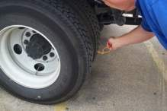
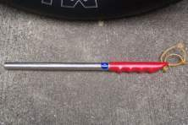
Manual Tire Inflation Systems
Gauge
Hammer
Tire Buddy

Slide 7
Central Tire Inflation Systems
Inflates or deflates for traction and load requirements
Expensive (over 15 times cost of an automatic tire inflation system)
Cannot be retrofitted on existing equipment

Slide 8
Tire Pressure Monitoring Systems (TPMS)
Tire Pressure Monitors
- Valve Stem Mounted
- Wheel Mounted
- Tire Mounted
TPMS Systems rely on an individual to physically add air to the tire

Slide 9
Why Automatic Tire Inflation?
To increase tire life
Running spec pressure ALL the time
Reduce downtimes
(not stuck on side of road)
To reduce overall fuel expense
To increase safety
Labor savings in checking tire pressures
Automatic Tire Inflation Systems adds air whenever the tire is below specification

Slide 10
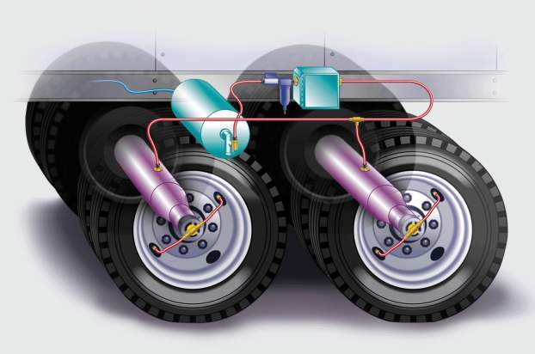
Meritor Tire Inflation System by PSI

Slide 11
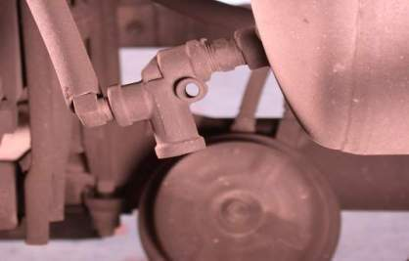
Pressure protection valve …
The MTIS includes a pressure protection valve that protects the air required for proper brake function. It only allows air compressed above 70 psi (4.8 Bar) to be used for tire pressure maintenance and if the pressure falls below that point no air can be diverted.

Slide 12
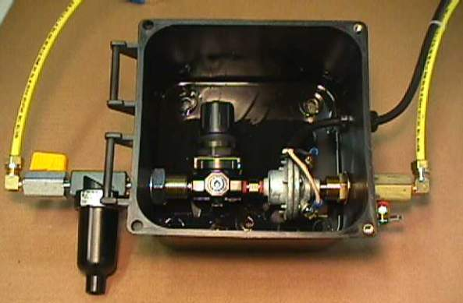
Control Box North America
From PP Valve
Flow Switch
Electrical Line Port
On-Off Valve
To Axles
Filter
Pressure Regulator
System Drain

Slide 13
Shut-off valve …
At times, you may find it necessary to drain the system for maintenance or service. The shut-off valve, mounted at the inlet of the control box, will allow air in the MTIS to be drained without draining the entire trailer brake system. On the road should there be some significant problem with MTIS, the entire system can be disabled by a simple turn of the valve.

Slide 14
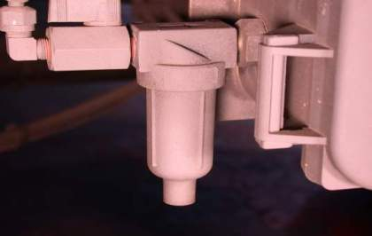
Filter…
The filter automatically removes contaminants.

Slide 15
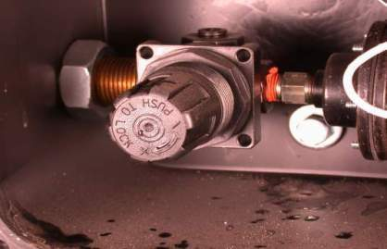
Pressure Regulator…
MTIS pre-sets the pressure regulator to the Customer’s specification during the manufacturing process. However, should the pressure requirements change, like changing from duals to singles, the regulator is easily adjusted to accommodate the new requirements.

Slide 16
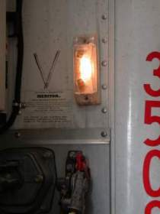
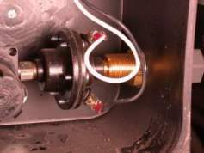
The flow switch activates the warning light…
One significant benefit of MTIS, aside from the automatic maintenance of trailer tire pressure, is the visible warning for the driver that there may be a tire problem. This early warning can help reduce tire failure by providing an opportunity to correct the tire problem in a timely manner.

Slide 17
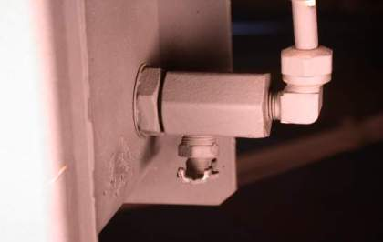
Drain petcock…
The drain petcock, when used in conjunction with the shut-off valve, allows the system to be fully drained without draining the entire brake system.

Slide 18
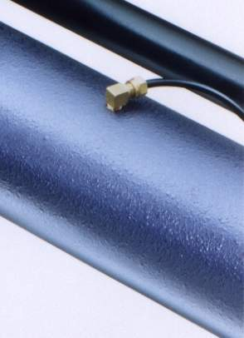
Axle Connection

Slide 19
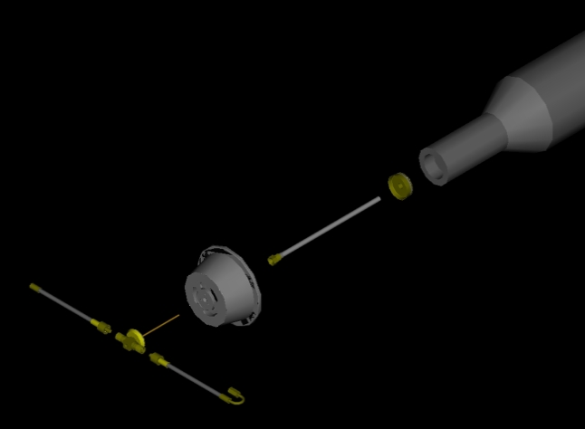
Wheel End
Spindle
Press Plug
Stator
Hubcap
Inside Hose
Outside Hose
Through-Tee Assembly
(includes Deflector Shield & Flapper)

Slide 20
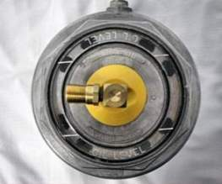
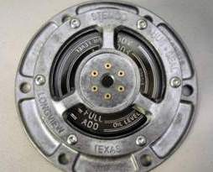
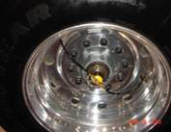
Thru-Tee is hand tightened into hubcap – Works with either duals or wide-base singles
Hubcap with 6 vents – Prevents wheel end pressure buildup

Slide 21
Quality Assurance
Every key component tested 100%

Slide 22
MTIS by PSI with
ThermALERT™

Slide 23
Wheel-Offs & Trailer Fires

Slide 24
ThermAlert Video

Slide 25
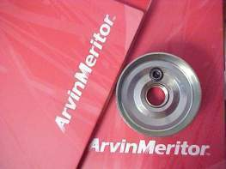
ThermALERT™ Features & Benefits
ThermALERT™ is a value added option when you purchase MTIS – the proven leader with nearly two million tires protected.
New patented ThermALERT™ technology leverages MTIS system.
Helps alert drivers to stop for repairs before serious damage occurs due to elevated wheel-end temperatures.
Helps reduce downtime, risk and operating cost.
ThermALERTTM helps alert drivers to stop for repairs before serious damage occurs due to elevated wheel-end temperatures

Slide 26
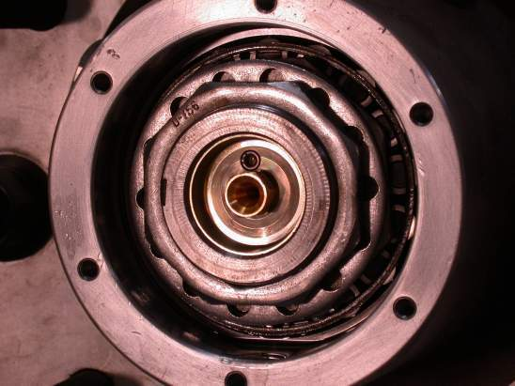
Eutectic Heat Sensor Plug

Slide 27
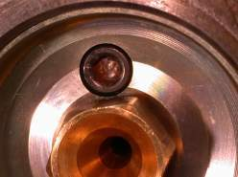
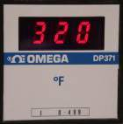
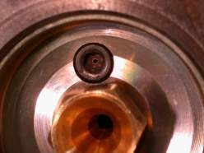
Plug Intact
Air Escapes

Slide 28
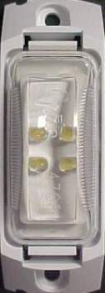
ThermALERTTM : Warning Light
If the indicator light comes ON during operation, the driver should immediately find a safe place to pull over, stop and assess the problem.
The warning light illumination can be caused by one or more of the following reasons:
Damaged inflation system components
System unable to keep up with a leaking tire
Wheel-end temperature is high enough to activate the ThermALERT™ warning system

Slide 29
Military Application - Israel
Israel military (IDF) conducted an evaluation of PSI in 2008 on a Talbert tri-axle trailer used for hauling tanks
Based on the successful performance of the PSI system, 100 Talbert military trailers currently running with PSI
Future new trailer specs all with PSI
Program initiated March 2011 to retrofit 30 year old tank trailer with PSI system
Success evaluation by IDF
Potential to retrofit over 1,000 trailers
All new trailers purchased by IDF now being speced with PSI automatic tire inflation system

Slide 30
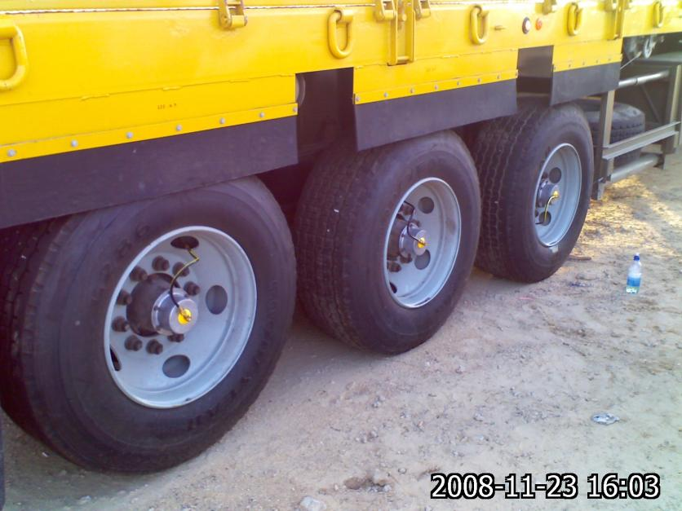
Israel Military Installation Talbert Tank Trailer

Slide 31
PSI Demo – April 2009
EMIP Military Program –
Expedited Modernization Initiative Procedure
Demo of PSI to EMIP team at Selfridge Air National Guard Base in Michigan April 2009

Slide 32
Letter of Recommendation

Slide 33
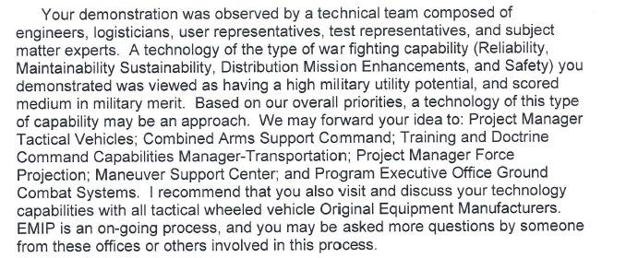
Letter of Recommendation – con’t

Slide 34
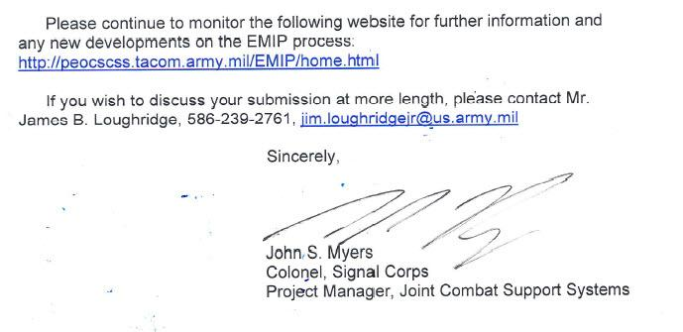
Letter of Recommendation – con’t

Slide 35
PSI Installation Options
Available through Original Equipment trailer manufacturer’s
Retrofit existing trailers

Slide 36
Fjording
Based on experience after Hurricane Katrina (trailers sat for extended periods in deep water), there were no performance issues associated with the PSI automatic tire inflation system

Slide 37
US Military Opportunities
Retrofit existing trailers with PSI automatic tire inflation system
Spec PSI on new trailer orders

Slide 38
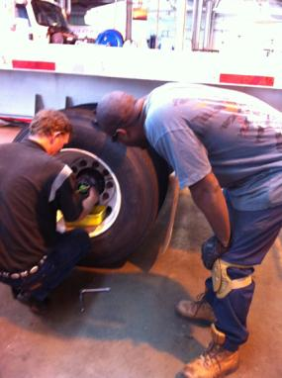
Camp Pendleton - Marines
Retrofitted 84 old flatbed trailers used to haul helicopters, tanks & heavy equipment with PSI
October 2010 Install
Installations were easy and straightforward
Contacts: Art Randolph & Don Elder

Slide 39
Camp Pendleton - Contacts

Slide 40
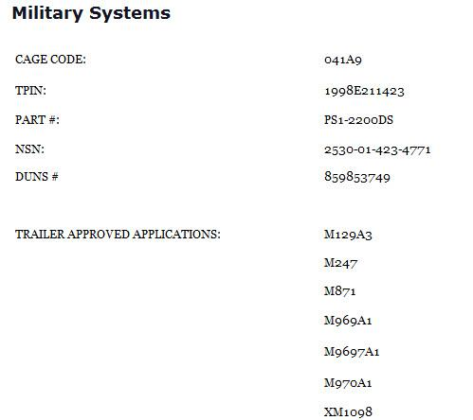

Slide 41
Commercial Fleets
FedEx
Werner
JB Hunt
Maverick Transportation
US Xpress
Old Dominion
America’s Top Trucking Fleets Use PSI Automatic Tire Inflation System
..

Slide 43
Return on Investment
Typical PSI system is around $1200 depending on specific axle make/model for many tandem and tri-axle trailers
OE or Retrofit
4 man-hours to retrofit
ROI is under 12 months
Fuel economy
Downtime reduction
Mileage increase
Safety – Not stuck on side of road

Slide 44
Pressure Systems International – (PSI) San Antonio, Texas “Automatic Tire Inflation System for Military Trailers”
Al Cohn, Director New Market Development & Eng Support
Pressure Systems International (PSI)
July 2012
P.S.I.'s ATIS is covered by one or more of the following U.S. Patents: 5,287,906; 5,584,949; 5,767,398; 5,769,979; 6,131,631; 6,698,482; 5,377,736; 5,538,062; 5,868,881; 6,269,691; 6,435,238; 6,892,778

